Slide 1
A vehicle that relies on vision sensors for automatic tracking
Name:YE JIANZE
Number:2310176
--preparations
--Link
--Code

Slide 2
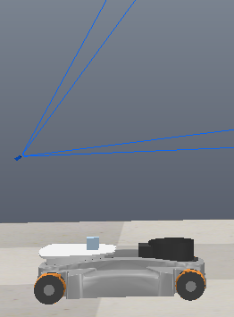
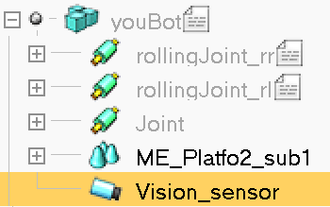
Vehicle and camera setup

Slide 3
Connecting to ceppeliasim using zmqremote
client = RemoteAPIClient()
sim = client.require('sim')
defaultIdleFps = sim.getInt32Param(sim.intparam_idle_fps)
sim.setInt32Param(sim.intparam_idle_fps, 0)
client.setStepping(False)
sim.startSimulation()

Slide 4
Read camera information and get vehicle control
wheelJoints = [1,1,1,1] #wheel joints handle
wheelJoints[0] = sim.getObject('./rollingJoint_fl')
wheelJoints[1] = sim.getObject('./rollingJoint_rl')
wheelJoints[2] = sim.getObject('./rollingJoint_rr')
wheelJoints[3] = sim.getObject('./rollingJoint_fr')
visionSensorHandle = sim.getObject('./Vision_sensor')

Slide 5
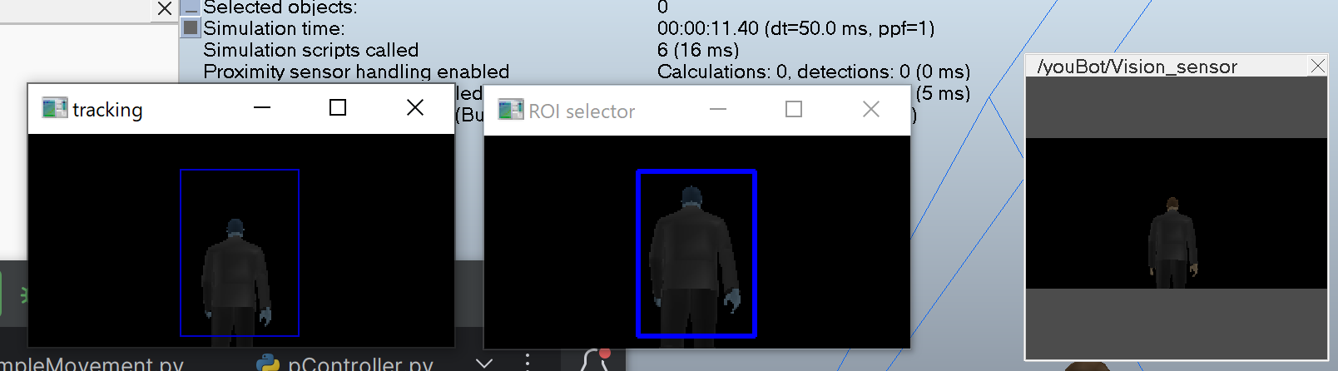
image processing
img, [resX, resY] = sim.getVisionSensorImg(visionSensorHandle)
resolution, [resX, resY] = sim.getVisionSensorImg(visionSensorHandle)
img = np.frombuffer(img, dtype=np.uint8).reshape(resY, resX, 3)

Slide 6
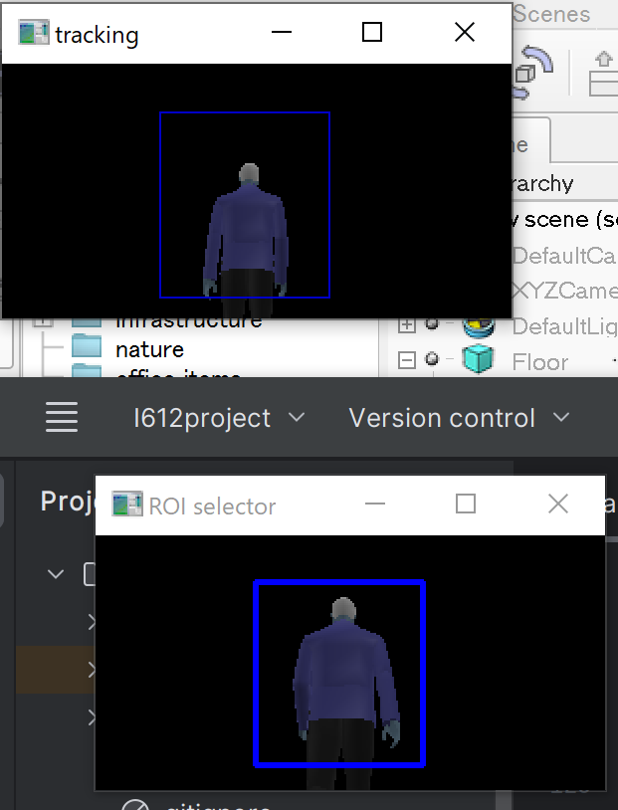
Camera tracking by using the KCF algorithm
tracker = cv2.TrackerKCF_create()
bbox1 = cv2.selectROI(image, False)
tracker.init(image, bbox1)
while (time.time() - t) < 180:
image = readVisionSensor()
success, bbox = tracker.update(image)
if success:
p1 = (int(bbox[0]), int(bbox[1]))
p2 = (int(bbox[0] + bbox[2]), int(bbox[1] + bbox[3]))
cv2.rectangle(image, p1, p2, (200, 0, 0))

Slide 7
Control the vehicle in the loop
def actuate_car(forwBackVel,leftRightVel,rotVel): #set four wheel speed according to vx,vy,w
v0 = (-forwBackVel + leftRightVel + rotVel) / r
v1 = (-forwBackVel - leftRightVel + rotVel) / r
v2 = (-forwBackVel + leftRightVel - rotVel) / r
v3 = (-forwBackVel - leftRightVel - rotVel) / r
sim.setJointTargetVelocity(wheelJoints[0], v0)
sim.setJointTargetVelocity(wheelJoints[1], v1)
sim.setJointTargetVelocity(wheelJoints[2], v2 )
sim.setJointTargetVelocity(wheelJoints[3], v3)
time.sleep(0.2) # loop executes once every 0.2 seconds (= 5 Hz)

Slide 8
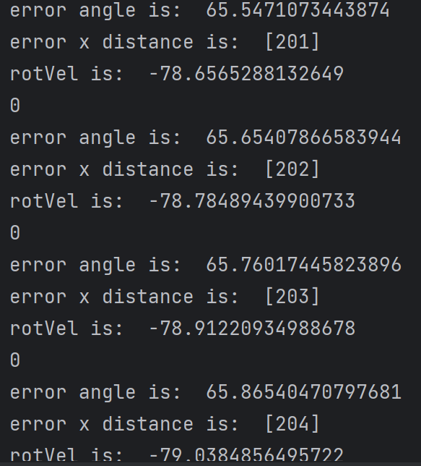
Calculation of the angle of rotation based on the boundingbox's offset from the centre
centerx = (int(bbox[0]) + int(bbox[2]) // 2)
centery = (int(bbox[1]) + int(bbox[3]) // 2)
target_center_x.append(centerx)
target_center_y.append(centery)
theta1 = (math.atan(2.0 * (centerx - resolution[0] / 2) * math.tan(persAngle * PI / 360.0) / 128)) * 180 / PI sight_angle=theta1

